Slide 1
Figures – Chapter 11

Slide 2
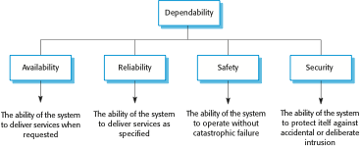
Figure 11.1 Principal dependability properties

Slide 3
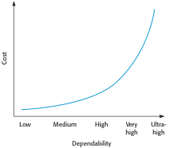
Figure 11.2 Cost/dependability curve

Slide 4
Figure 11.3 Reliability terminology
Term | Description
Human error or mistake | Human behavior that results in the introduction of faults into a system. For example, in the wilderness weather system, a programmer might decide that the way to compute the time for the next transmission is to add 1 hour to the current time. This works except when the transmission time is between 23.00 and midnight (midnight is 00.00 in the 24-hour clock).
System fault | A characteristic of a software system that can lead to a system error. The fault is the inclusion of the code to add 1 hour to the time of the last transmission, without a check if the time is greater than or equal to 23.00.
System error | An erroneous system state that can lead to system behavior that is unexpected by system users. The value of transmission time is set incorrectly (to 24.XX rather than 00.XX) when the faulty code is executed.
System failure | An event that occurs at some point in time when the system does not deliver a service as expected by its users. No weather data is transmitted because the time is invalid.

Slide 5
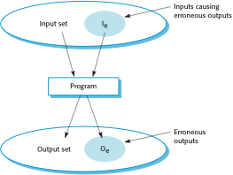
Figure 11.4 A system as an input/output mapping

Slide 6
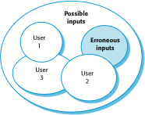
Figure 11.5 Software usage patterns</

Slide 7
Figure 11.6 Safety terminology
Term | Definition
Accident (or mishap) | An unplanned event or sequence of events which results in human death or injury, damage to property, or to the environment. An overdose of insulin is an example of an accident.
Hazard | A condition with the potential for causing or contributing to an accident. A failure of the sensor that measures blood glucose is an example of a hazard.
Damage | A measure of the loss resulting from a mishap. Damage can range from many people being killed as a result of an accident to minor injury or property damage. Damage resulting from an overdose of insulin could be serious injury or the death of the user of the insulin pump.
Hazard severity | An assessment of the worst possible damage that could result from a particular hazard. Hazard severity can range from catastrophic, where many people are killed, to minor, where only minor damage results. When an individual death is a possibility, a reasonable assessment of hazard severity is ‘very high’.
Hazard probability | The probability of the events occurring which create a hazard. Probability values tend to be arbitrary but range from ‘probable’ (say 1/100 chance of a hazard occurring) to ‘implausible’ (no conceivable situations are likely in which the hazard could occur). The probability of a sensor failure in the insulin pump that results in an overdose is probably low.
Risk | This is a measure of the probability that the system will cause an accident. The risk is assessed by considering the hazard probability, the hazard severity, and the probability that the hazard will lead to an accident. The risk of an insulin overdose is probably medium to low.

Slide 8
Figure 11.7 Security terminology
Term | Definition
Asset | Something of value which has to be protected. The asset may be the software system itself or data used by that system.
Exposure | Possible loss or harm to a computing system. This can be loss or damage to data, or can be a loss of time and effort if recovery is necessary after a security breach.
Vulnerability | A weakness in a computer-based system that may be exploited to cause loss or harm.
Attack | An exploitation of a system’s vulnerability. Generally, this is from outside the system and is a deliberate attempt to cause some damage.
Threats | Circumstances that have potential to cause loss or harm. You can think of these as a system vulnerability that is subjected to an attack.
Control | A protective measure that reduces a system’s vulnerability. Encryption is an example of a control that reduces a vulnerability of a weak access control system

Slide 9
Figure 11.8 Examples of security terminology
Term | Example
Asset | The records of each patient that is receiving or has received treatment.
Exposure | Potential financial loss from future patients who do not seek treatment because they do not trust the clinic to maintain their data. Financial loss from legal action by the sports star. Loss of reputation.
Vulnerability | A weak password system which makes it easy for users to set guessable passwords. User ids that are the same as names.
Attack | An impersonation of an authorized user.
Threat | An unauthorized user will gain access to the system by guessing the credentials (login name and password) of an authorized user.
Control | A password checking system that disallows user passwords that are proper names or words that are normally included in a dictionary.

